Slide 1
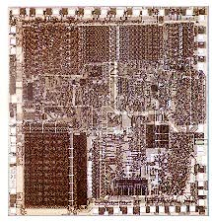
8086/8088 Microprocessor and its pin configuration
REFERENCES:
1. MICROPROCESSORS AND INTERFACING PROGRAMMING AND HARDWARE, SECOND EDITION, D.V. HALL – CHAPTER 7, CHAPTER 11

Slide 2
Topics
Basic Features
Pin Diagram
Minimum and Maximum modes
Description of the pins

Slide 3
Basic Features
8086 announced in 1978; 8086 is a 16 bit microprocessor with a 16 bit data bus
8088 announced in 1979; 8088 is a 16 bit microprocessor with an 8 bit data bus
Both manufactured using High-performance Metal Oxide Semiconductor (HMOS) technology
Both contain about 29000 transistors
Both are packaged in 40 pin dual-in-line package (DIP)

Slide 4
8086/8088 Pin Diagrams
GND
1
40
VCC
GND
1
40
VCC
AD14
2
39
AD15
A14
2
39
A15
AD13
3
38
A16/S3
A13
3
38
A16/S3
AD12
4
37
A17/S4
A12
4
37
A17/S4
AD11
5
36
A18/S5
A11
5
36
A18/S5
AD10
6
35
A19/S6
A10
6
35
A19/S6
AD9
7
34
BHE/S7
A9
7
34
SS0
AD8
8
8086
33
MN/MX
A8
8
8088
33
MN/MX
AD7
9
32
RD
AD7
9
32
RD
AD6
10
31
HOLD
AD6
10
31
HOLD
AD5
11
30
HLDA
AD5
11
30
HLDA
AD4
12
29
WR
AD4
12
29
WR
AD3
13
28
M/IO
AD3
13
28
IO/M
AD2
14
27
DT/R
AD2
14
27
DT/R
AD1
15
26
DEN
AD1
15
26
DEN
AD0
16
25
ALE
AD0
16
25
ALE
NMI
17
24
INTA
NMI
17
24
INTA
INTR
18
23
TEST
INTR
18
23
TEST
CLK
19
22
READY
CLK
19
22
READY
GND
20
21
RESET
GND
20
21
RESET
BHE has no meaning on the 8088 and has been eliminated

Slide 5
Multiplex of Data and Address Lines in 8088
Address lines A0-A7 and Data lines D0-D7 are multiplexed in 8088. These lines are labelled as AD0-AD7.
By multiplexed we mean that the same physical pin carries an address bit at one time and the data bit another time
GND
1
40
VCC
A14
2
39
A15
A13
3
38
A16/S3
A12
4
37
A17/S4
A11
5
36
A18/S5
A10
6
35
A19/S6
A9
7
34
SS0
A8
8
8088
33
MN/MX
AD7
9
32
RD
AD6
10
31
HOLD
AD5
11
30
HLDA
AD4
12
29
WR
AD3
13
28
IO/M
AD2
14
27
DT/R
AD1
15
26
DEN
AD0
16
25
ALE
NMI
17
24
INTA
INTR
18
23
TEST
CLK
19
22
READY
GND
20
21
RESET

Slide 6
Multiplex of Data and Address Lines in 8086
Address lines A0-A15 and Data lines D0-D15 are multiplexed in 8086. These lines are labeled as AD0-AD15.
GND
1
40
VCC
AD14
2
39
AD15
AD13
3
38
A16/S3
AD12
4
37
A17/S4
AD11
5
36
A18/S5
AD10
6
35
A19/S6
AD9
7
34
BHE/S7
AD8
8
8086
33
MN/MX
AD7
9
32
RD
AD6
10
31
HOLD
AD5
11
30
HLDA
AD4
12
29
WR
AD3
13
28
M/IO
AD2
14
27
DT/R
AD1
15
26
DEN
AD0
16
25
ALE
NMI
17
24
INTA
INTR
18
23
TEST
CLK
19
22
READY
GND
20
21
RESET

Slide 7
Minimum-mode and Maximum-mode Systems
8088 and 8086 microprocessors can be configured to work in either of the two modes: the minimum mode and the maximum mode
Minimum mode:
Pull MN/MX to logic 1
Typically smaller systems and contains a single microprocessor
Cheaper since all control signals for memory and I/O are generated by the microprocessor.
Maximum mode
Pull MN/MX logic 0
Larger systems with more than one processor (designed to be used when a coprocessor (8087) exists in the system)
GND
1
40
VCC
AD14
2
39
AD15
AD13
3
38
A16/S3
AD12
4
37
A17/S4
AD11
5
36
A18/S5
AD10
6
35
A19/S6
AD9
7
34
BHE/S7
AD8
8
8086
33
MN/MX
AD7
9
32
RD
AD6
10
31
HOLD
AD5
11
30
HLDA
AD4
12
29
WR
AD3
13
28
M/IO
AD2
14
27
DT/R
AD1
15
26
DEN
AD0
16
25
ALE
NMI
17
24
INTA
INTR
18
23
TEST
CLK
19
22
READY
GND
20
21
RESET
Lost Signals in
Max Mode

Slide 8
Minimum-mode and Maximum-mode Signals
GND
1
40
VCC
GND
1
40
VCC
AD14
2
39
AD15
AD14
2
39
AD15
AD13
3
38
A16/S3
AD13
3
38
A16/S3
AD12
4
37
A17/S4
AD12
4
37
A17/S4
AD11
5
36
A18/S5
AD11
5
36
A18/S5
AD10
6
35
A19/S6
AD10
6
35
A19/S6
AD9
7
34
BHE/S7
Vcc
AD9
7
34
BHE/S7
GND
AD8
8
8086
33
MN/MX
AD8
8
8086
33
MN/MX
AD7
9
32
RD
AD7
9
32
RD
AD6
10
31
HOLD
AD6
10
31
RQ/GT0
AD5
11
30
HLDA
AD5
11
30
RQ/GT1
AD4
12
29
WR
AD4
12
29
LOCK
AD3
13
28
M/IO
AD3
13
28
S2
AD2
14
27
DT/R
AD2
14
27
S1
AD1
15
26
DEN
AD1
15
26
S0
AD0
16
25
ALE
AD0
16
25
QS0
NMI
17
24
INTA
NMI
17
24
QS1
INTR
18
23
TEST
INTR
18
23
TEST
CLK
19
22
READY
CLK
19
22
READY
GND
20
21
RESET
GND
20
21
RESET
Min Mode
Max Mode

Slide 9
RESET Operation results
CPU component | Contents
Flags | Cleared
Instruction Pointer | 0000H
CS | FFFFH
DS, SS and ES | 0000H
Queue | Empty

Slide 10
S0, S1 and S2 Signals
S2 | S1 | S0 | Characteristics
0 | 0 | 0 | Interrupt acknowledge
0 | 0 | 1 | Read I/O port
0 | 1 | 0 | Write I/O port
0 | 1 | 1 | Halt
1 | 0 | 0 | Code access
1 | 0 | 1 | Read memory
1 | 1 | 0 | Write memory
1 | 1 | 1 | Inactive

Slide 11
A17/S4, A16/S3 Address/Status
A17/S4 | A16/S3 | Function
0 | 0 | Extra segment access
0 | 1 | Stack segment access
1 | 0 | Code segment access
1 | 1 | Data segment access

Slide 12
A19/S6, A18/S5 Address/Status
A18/S5: The status of the interrupt enable flag bit is updated at the beginning of each cycle. The status of the flag is indicated through this pin.
A19/S6: When Low, it indicates that 8086 is in control of the bus. During a "Hold acknowledge" clock period, the 8086 tri-states the S6 pin and thus allows another bus master to take control of the status bus.

Slide 13
QS0 and QS1 Signals
QS1 | QS0 | Characteristics
0 | 0 | No operation
0 | 1 | First byte of opcode from queue
1 | 0 | Empty the queue
1 | 1 | Subsequent byte from queue

Slide 14
INTA
Interrupt Acknowledge generated by the microprocessor in response to INTR. Causes the interrupt vector to be put onto the data bus.
BHE
Bus High Enable. Enables the most significant data bus bits (D15-D8) during a read or write operation.
VCC/GND
Power supply (5V) and GND (0V)
MN/MX
Select minimum (5V) or maximum mode (0V) of operation.

Slide 15
RQ/GT1 and RQ/GT0
Request/grant pins request/grant direct memory accesses (DMA) during maximum mode operation.
LOCK
Lock output is used to lock peripherals off the system. Activated by using the LOCK: prefix on any instruction.

Slide 16
INTR (input) Hardware Interrupt Request Pin
INTR is used to request a hardware interrupt.
It is recognized by the processor only when IF = 1, otherwise it is ignored (STI instruction sets this flag bit).
The request on this line can be disabled (or masked) by making IF = 0 (use instruction CLI)
If INTR becomes high and IF = 1, the 8086 enters an interrupt acknowledge cycle (INTA becomes active) after the current instruction has completed execution.

Slide 17
NMI (input) Non-Maskable Interrupt line
The Non Maskable Interrupt input is similar to INTR except that the NMI interrupt does not check to see if the IF flag bit is at logic 1.
This interrupt cannot be masked (or disabled) and no acknowledgment is required.
It should be reserved for “catastrophic” events such as power failure or memory errors.

Slide 18
8086 External Interrupt Connections
NMI - Non-Maskable Interrupt INTR - Interrupt Request
Programmable Interrupt Controller (part of chipset)
NMI Requesting Device
NMI
8086 CPU
Intel
8259A
PIC
INTR
Interrupt Logic
int
into
Divide
Error
Single
Step
Software
Traps
Notes:
‹#›

Slide 19
TEST (input)
The TEST pin is an input that is tested by the WAIT instruction.
If TEST is at logic 0, the WAIT instruction functions as a NOP.
If TEST is at logic 1, then the WAIT instruction causes the 8086 to idle, until TEST input becomes a logic 0.
This pin is normally driven by the 8087 co-processor (numeric coprocessor).

Slide 20
Ready (input)
This input is used to insert wait states into processor Bus Cycle.
If the READY pin is placed at a logic 0 level, the microprocessor enters into wait states and remains idle.
If the READY pin is placed at a logic 1 level, it has no effect on the operation of the processor.
It is sampled at the end of the T2 clock pulse
Usually driven by a slow memory device

Slide 21
HOLD (input)
The HOLD input is used by DMA controller to request a Direct Memory Access (DMA) operation.
If the HOLD signal is at logic 1, the microprocessor places its address, data and control bus at the high impedance state.
If the HOLD pin is at logic 0, the microprocessor works normally.

Slide 22
HLDA (output) Hold Acknowledge Output
Hold acknowledge is made high to indicate to the DMA controller that the processor has entered hold state and it can take control over the system bus for DMA operation.

Slide 23
8086 Memory Addressing
Data can be accessed from the memory in four different ways:
8 - bit data from Lower (Even) address Bank.
8 - bit data from Higher (Odd) address Bank.
16 - bit data starting from Even Address.
16 - bit data starting from Odd Address.

Slide 24
1. Accessing 8-bit data from Lower (Even) address bank :
The two bank memory module of 8086 based storage system requires one bus-cycle to read/write a data-byte.
To access a Byte of data in Low-bank, valid address is provided via address pins A1 to A19 together with A0=’0’ and BHE=’1’.

Slide 25
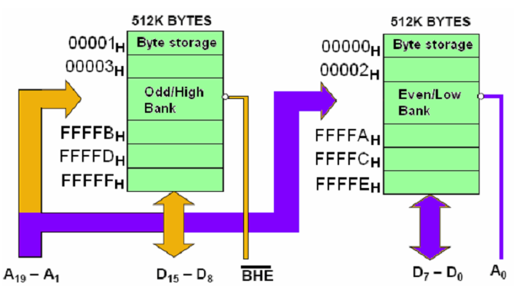

Slide 26
2. Accessing 8-bit data from Higher (Odd) address bank
Similarly to access a Byte of data in High-bank, valid address in pins A1 to A19, A0=’1’ and BHE=’0’ are required to access the data through D8 to D15 of the data-bus.
These signals disable the Low bank and enable the High bank to transfer (in/out) data through D8 to D15 of the data-bus.

Slide 27
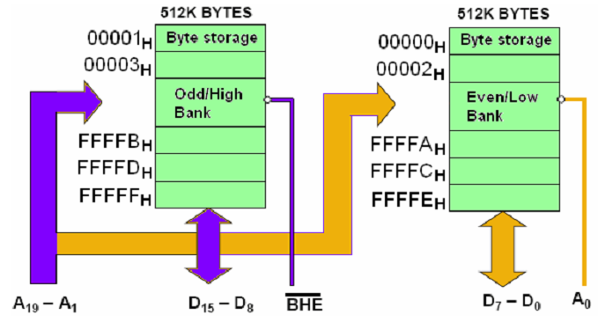

Slide 28
3. Accessing 16 - bit data starting from Even Address.
For even-addressed (aligned) words, only one bus-cycle is needed to access the word, as both low and high banks are activated at the same time using A0=’0’ and BHE=’0’
Note that during this bus-cycle, all 16-bit data is transferred via D0 to D15 of the data bus.
Notes:
‹#›

Slide 29
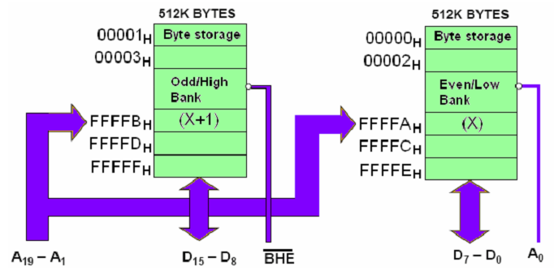

Slide 30
4. Accessing 16 - bit data starting from Odd Address.
For odd-addressed (unaligned) words (with odd P.A of the LSB), two bus-cycles are required to access the Word-data.
During the 1st bus-cycle, odd addressed LSB of the word is accessed from the High-memory-bank via D8 to D15 of data bus

Slide 31
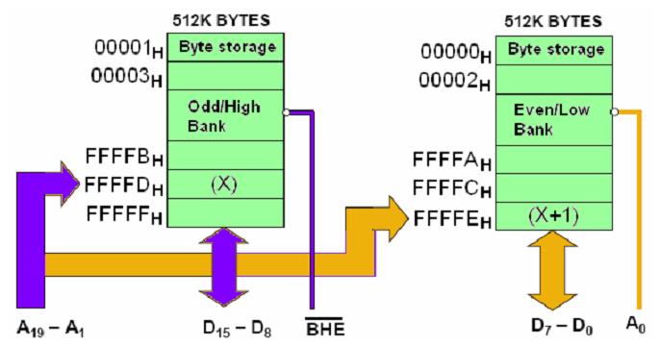

Slide 32
During 2nd bus-cycle, P.A. is auto-incremented to access the even address MSB of the word from the Low bank via D0 to D7.
Note that A0 and BHE signals are reset (violet) accordingly to enable the required memory bank.

Slide 33
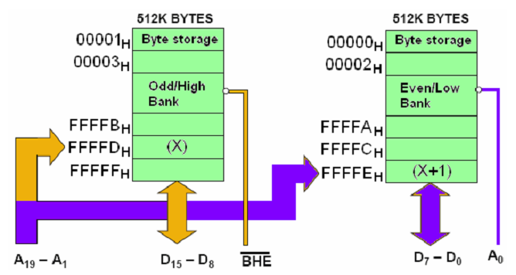

Slide 34
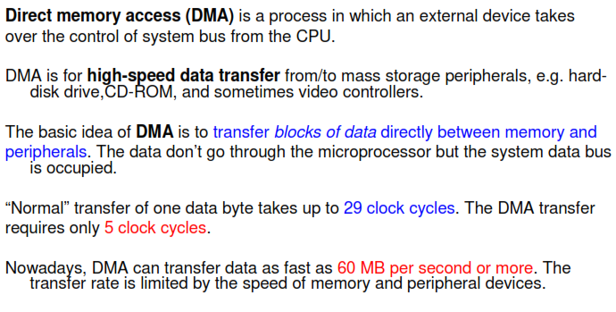
Direct Memory Access (DMA)

Slide 35
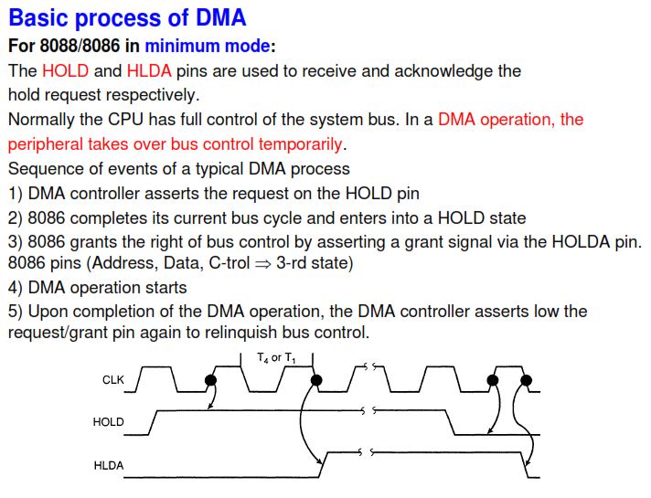

Slide 36
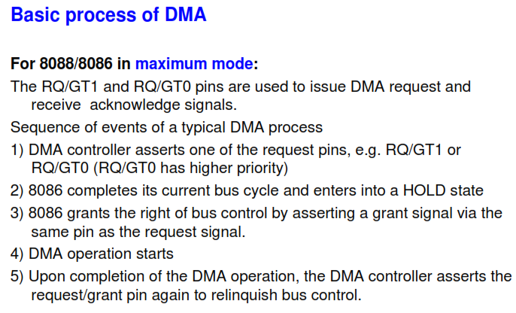

Slide 37
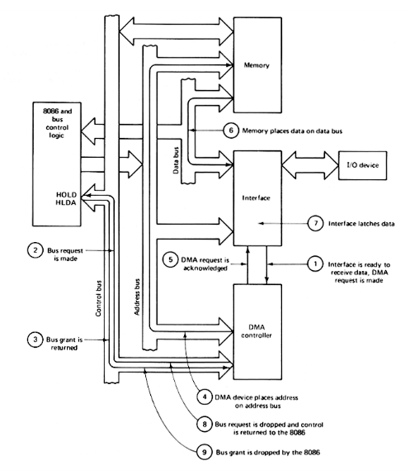

Slide 38
